Slide 1
CPSC 375 Introduction to Data Science and Big Data Analytics
Dr. Anand Panangadan
apanangadan@fullerton.edu

Slide 2
What we will cover this week
Common text processing steps
Using the tidytext package in R
Comparing text data

Slide 3
Social media analytics trends
Metrics: demise of “vanity” metrics (likes, dislikes)
Decline of corporations and government trust, the rise of micro-influencers
Social commerce
Social listening: tracking conversations, identify recurring phrases, words or brands, identify uncovered demands and opportunities
Introduction to social media analysis in R
Maria Prokofivea, Saskia Freytag and Anna Quaglieri
R-Ladies/Victoria University (Australia)

Slide 4
Terminology
Corpus: the dataset
Document: the unit of data for classification
News article
Tweet
Amazon review
Sentence: unit of written language
Token: a word in a document
A corpus contains documents; each document is a collection of tokens
Vocabulary: distinct words in a dataset

Slide 5
Text analysis
Text pre-processing
Word frequencies
Classification
Sentiment analysis
Results/
Visualization

Slide 6
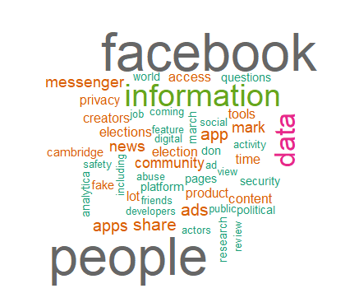
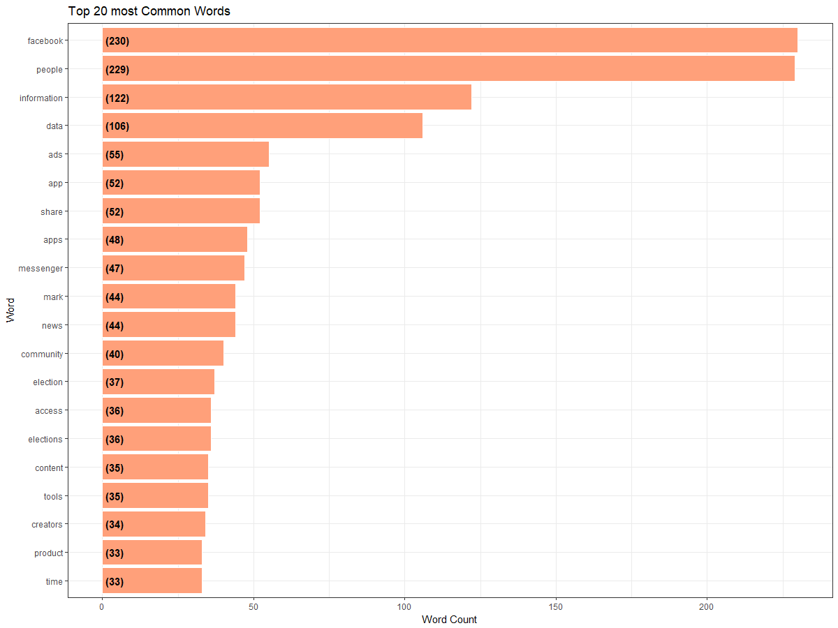
Visualising text data
Word Frequency:
see trends and patterns
check accuracy of pre-processing
Word Clouds:

Slide 7
Data preparation:
A token: a meaningful unit of text
a word, a sentence
Tokenization: splitting the text into these smaller linguistic units

Slide 8
What is a word?
e.g., are cat and cats the same word?
September and Sept?
zero and oh?
Is _ a word? * ? ) . ,
How many words are there in don’t ? Gonna ?
Japanese and Chinese text: how do we identify a word?
Word is well defined unit in western languages – e.g. Chinese has different notion of semantic unit

Slide 9
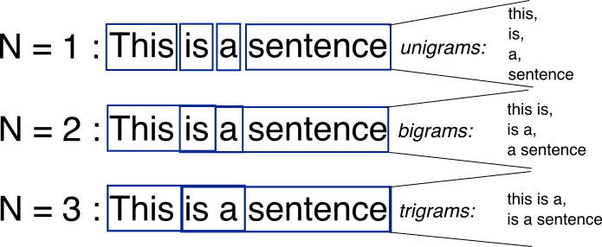
Data preparation:
Split the text into smaller linguistic units
words are separated by whitespace, punctuation marks or line breaks
Not perfect: “Los Angeles” and “rock 'n' roll”?
Which token to use?
“N-grams”: consecutive sequences of words
“this is” (2-gram or bigram)

Slide 10
Text processing in R
Two major approaches/libraries
library(tidytext)
Uses the tidy data principle
tibble data type
Uses data wrangling functions for text processing
library(tm) # text mining
Vcorpus data type to hold text data
Special functions to transform the data

Slide 11
Text corpus: tidy data
Tidy data: a table with one-token-per-row
Each variable (=token) is a column
Each observation is a row
Each type of observational unit is a table
https://www.tidytextmining.com/tidytext.html

Slide 12
Convert tweets to the tidy text format:
Install “tidytext” package
unnest_tokens()
data %>% unnest_tokens(input = "text", output = "word")
Breaks up strings in the input column to tokens
Tokens are in the new output column
mydata %>% unnest_tokens(input = "text", output = "word")
input column (named text) contains strings
output column (named word) contains tokens

Slide 13
Classwork
Execute these R commands
library(tidyverse)
text <- c("Because I could not stop for Death -",
"He kindly stopped for me -",
"The Carriage held but just Ourselves -",
"and Immortality")
text_df <- tibble(line = 1:4, text = text)
text_df %>% unnest_tokens(input=text, output="word")

Slide 14
Classwork
View the output of the previous step
text_df %>% unnest_tokens(input=text, output="word") %>% view()
Are they all lower or upper case?
Any other changes?

Slide 15
Data preparation
Common pre-processing steps
Convert to lower case
Remove punctuation
Must be careful when processing social media data
#hashtags, @mentions, URLs
Not punctuation, are case-sensitive
unnest_tokens() understands tweets
mydata %>% unnest_tokens(input=…, output=…, token="tweets")

Slide 16
Word frequency
Count how many times each word appears
A common type of analysis
“Counts” also called “frequency”
In R:
… %>% group_by(word) %>% summarise(n())
Shorter, more readable:
… %>% count(word)

Slide 17
Classwork
Analyze the tweets in file "hashcsufnew.csv”
Read the CSV file
Select only the tweet column
Make it into a tidytext format
Count word occurrences
Which are the most common words?
Which are the most common hashtags?

Slide 18
Plotting the results
To create a bar chart:
ggplot(data=airquality) +geom_col(aes(Month,Ozone))

Slide 19
Plotting the results
To create a bar chart:
ggplot(data=airquality) +geom_col(aes(Month,Ozone)) + coord_flip()

Slide 20
Classwork
Draw a word cloud of the words from the CSUF tweets
Read the CSV file "hashcsufnew.csv” (read_csv)
Select only the tweet column (select)
Make it into a tidytext format (unnest_tokens)
Count word occurrences (count)
Keep only word occurrences > 200 (filter)
Save your result in some object
Draw a bar chart of the word counts
Previous steps

Slide 21
Word clouds
Showing words with different font sizes, colors according to their “importance”
“Importance”: Usually word frequency/counts

Slide 22
Word clouds
library(wordcloud)
Install the wordcloud package first
wordcloud(mywords, mywordcounts, max.words =20)

Slide 23
Classwork
Create any word cloud (with your own words and word counts)
Example:
wordcloud(c("Hello", "how", "are", "you"), c(50,40,20,40))

Slide 24
Classwork
Draw a word cloud of the words from the CSUF tweets
Read the CSV file "hashcsufnew.csv” (read_csv)
Select only the tweet column (select)
Make it into a tidytext format (unnest_tokens)
Count word occurrences (count)
Keep only word occurrences > 200 (filter)
Save your result in some object
Create a word cloud from these words
Previous steps

Slide 25
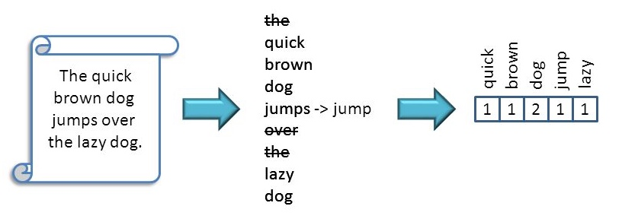
Data preparation:
Stopwords
most common words in a language
Needed for grammatically correct language
But simple word-based analysis can ignore these
the, is, at, which, and on
Be careful! "The Who"

Slide 26
Stopwords
Stopwords vary with language:
English: A, ABOUT, ABOVE, ACROSS, AFTER, AGAIN, AGAINST, ALL, ALMOST, ALONE, ALONG, ALREADY, ...
Dutch: de, en, van, ik, te, dat, die, in, een, hij, het, niet, zijn, is, was, op, aan, met, als, voor, had, er, maar, om, hem, dan, zou, of, wat, mijn, men, dit, zo, ...
Slovenian: A, AH, AHA, ALI, AMPAK, BAJE, BODISI, BOJDA, BRŽKONE, BRŽČAS, BREZ, CELO, DA, DO, ...

Slide 27
Remove stopwords
stop_words
A table of stop words in the tidytext package
A column called “word” has the stop words
If both data and stopwords are in tidy data format (one word per row), then
removing stop words is an anti_join()

Slide 28
Classwork
Execute these R commands
library(tidyverse)
text <- c("Because I could not stop for Death -",
"He kindly stopped for me -",
"The Carriage held but just Ourselves -",
"and Immortality")
text_df <- tibble(line = 1:4, text = text)
text_df %>% unnest_tokens(input=text, output=word)
text_df %>% unnest_tokens(input=text, output=word) %>%
anti_join(stop_words)

Slide 29
Classwork
Remove stop words from the CSUF tweets
Read the CSV file "hashcsufnew.csv” (read_csv)
Select only the tweet column (select)
Make it into a tidytext format (unnest_tokens)
Count word occurrences (count)
Keep only word occurrences > 200 (filter)
Save your result in some object
Remove stop words (anti_join)
Create a word cloud from these words
Previous steps

Slide 30
Stemming
Different forms of the same word (e.g., learns, learned, learning,…) have similar meaning but different spelling
problematic for text data analysis
Stemming
process of transforming a word into its most important part: its stem
Stemming merges different forms of a word into one

Slide 31
Stemming
Stemming is done using a sequence of rules
NOT by looking up a dictionary
Therefore:
It is computationally efficient
But not perfect

Slide 32
Porter stemming (example rules)
From |  | To |  | From |  | To
AT | → | ATE |  | conflat(ed) | → | conflate
BL | → | BLE |  | troubl(ed) | → | trouble
IZ | → | IZE |  | siz(ed) | → | size
(*d and not (*L or *S or *Z)) | → | single letter |  | hopp(ing) | → | hop
(m=1 and *o) | → | E |  | tann(ed) | → | tan
 |  |  |  | fall(ing) | → | fall
 |  |  |  | hiss(ing) | → | hiss
 |  |  |  | fizz(ed) | → | fizz
 |  |  |  | fail(ing) | → | fail
 |  |  |  | fil(ing) | → | file

Slide 33
Word stemming in R
wordStem()
Part of the SnowballC package
Automatically installed with tidytext
Just load it:
library(SnowballC)
… %>% mutate(word = wordStem(word))

Slide 34
Classwork
Remove stop words from the CSUF tweets
Read the CSV file "hashcsufnew.csv” (read_csv)
Select only the tweet column (select)
Make it into a tidytext format (unnest_tokens)
Remove stop words (anti_join)
Stem the words
Count word occurrences (count)
Keep only word occurrences > 200 (filter)
Save your result in some object
Create a word cloud from these words
Previous steps

Slide 35
Text classification
Term Frequency – Inverse Document Frequency
Cosine similarity

Slide 36
Document Categorization Task
Given: set of documents labeled with content categories
The goal: to build a model which would automatically assign right content categories to new unlabeled documents.
Content categories can be:
unstructured (e.g., Reuters) or
structured (e.g., Yahoo, Medline)

Slide 37
Document categorization
???
unlabeled
document
Classification algorithm
Classifier
labeled documents
document category
(label)

Slide 38
Text representation for classification
Represent documents as vectors
Each term/word is a dimension
Terms are axes of the space
Documents are points or vectors in this space
Very high-dimensional:
tens of thousands of dimensions for English text
But very sparse vectors
Many words in the corpus, but each document contains only a few words
most entries are zero

Slide 39
Representing documents as vectors
Completely ignore the linguistic structure within the text
Order of words is not important
John is quicker than Mary and Mary is quicker than John have the same vectors
Called “Bag-Of-Words” or “Vector-Space” model
After converting to a vector-space model, can do:
Classification
Clustering

Slide 40
Binary term-document incidence matrix
Each document is represented by a binary vector ∈ {0,1}^{|V|}

Slide 41
Term-document count matrices
Consider the number of occurrences of a term in a document:
Each document is a count vector

Slide 42
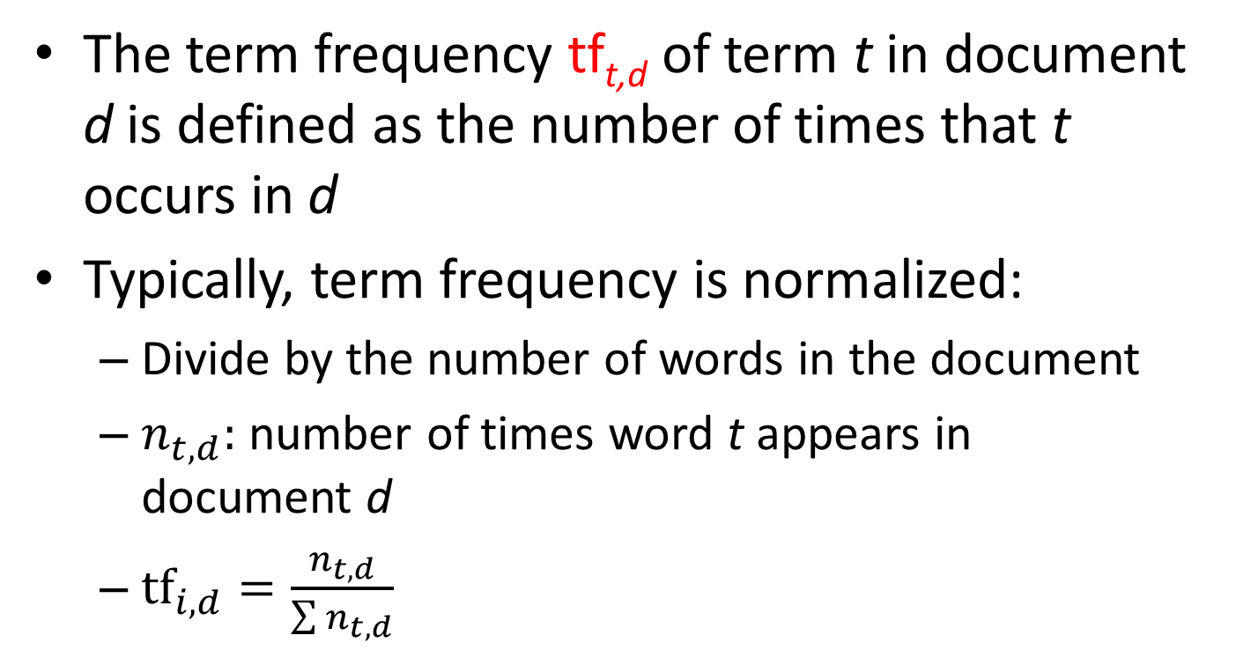
Term frequency
The term frequency tf_{t,d} of term t in document d is defined as the number of times that t occurs in d
Typically, term frequency is normalized:
Divide by the number of words in the document
$n_{t,d}:$ number of times word t appears in document d
$tf_{i,d}=\frac{n_{t,d}}{\sum{n_{t,d}}}$

Slide 43
Document frequency
Words that appear in only a few documents are more informative than frequent terms
Frequent words: the, is
Rare word: arachnocentric
Want a high weight for rare terms like arachnocentric.

Slide 44
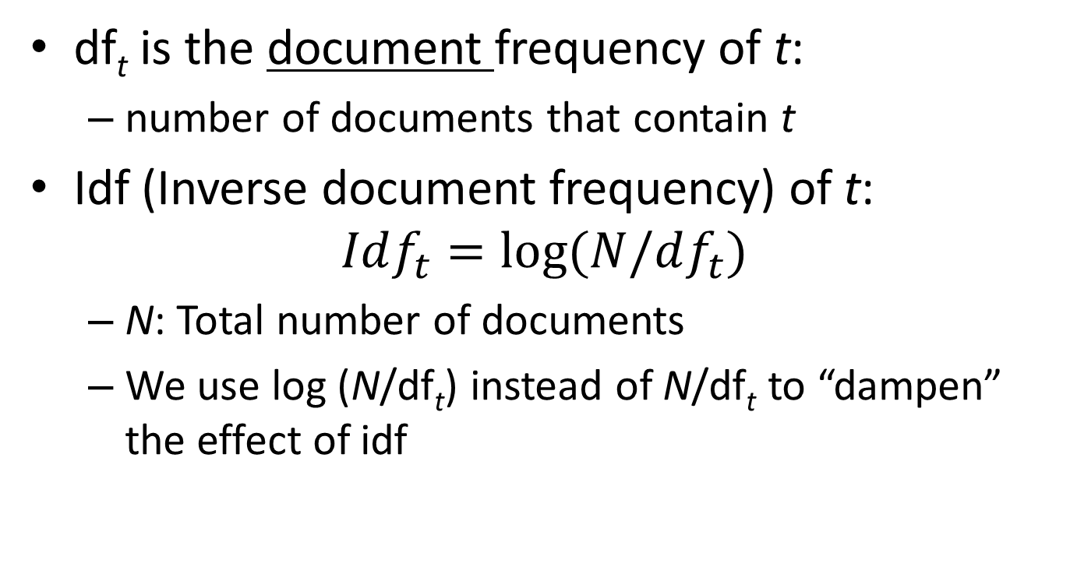
Inverse document frequency (idf)
df_{t} is the document frequency of t:
number of documents that contain t
Idf (Inverse document frequency) of t:
$$Idf_{t}=\log{(N/df_{t})}$$
N: Total number of documents
We use log (N/df_{t}) instead of N/df_{t} to “dampen” the effect of idf

Slide 45

idf example, suppose N = 1 million
term | df_{t} | idf_{t}
calpurnia | 1 | 13.85?
animal | 100 | 9.2?
sunday | 1,000 | 6.9?
fly | 10,000 | ?
under | 100,000 | ?
the | 1,000,000 | 0?
$$Idf_{t}=\log{(N/df_{t})}$$
Note: there is one idf value for each term t in the corpus
Notes:
6 4 3 2 1 0

Slide 46
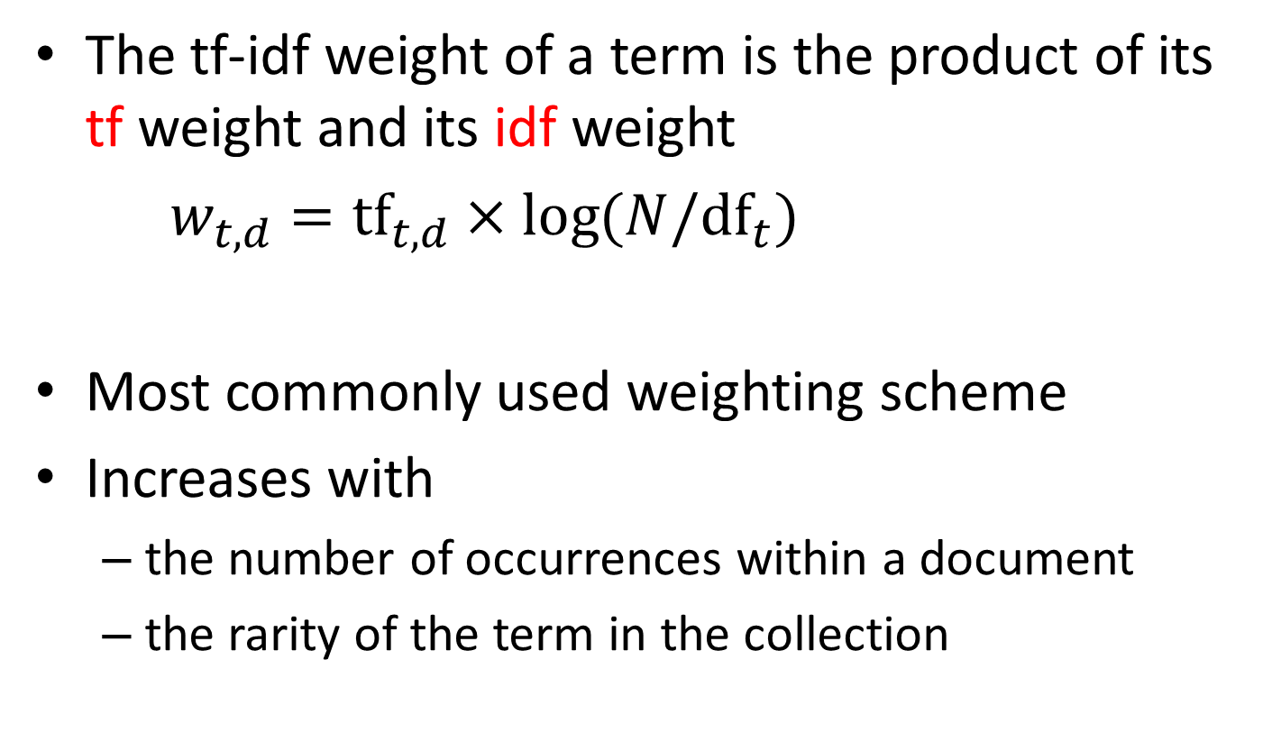
tf-idf weighting
The tf-idf weight of a term is the product of its tf weight and its idf weight
$w_{t,d}=tf_{t,d}×\log{(N/df_{t})}$
Most commonly used weighting scheme
Increases with
the number of occurrences within a document
the rarity of the term in the collection

Slide 47
Binary → count → weight matrix
Each document is now represented by a real-valued vector of tf-idf weights

Slide 48
Class work
Represent these three documents as tf-idf vectors
Document 1: see spot
Document 2: see spot run
Document 3: run spot run

Slide 49
Example document and its vector representation
TRUMP MAKES BID FOR CONTROL OF RESORTS Casino owner and real estate Donald Trump has offered to acquire all Class B common shares of Resorts International Inc, a spokesman for Trump said. The estate of late Resorts chairman James M. Crosby owns 340,783 of the 752,297 Class B shares. Resorts also has about 6,432,000 Class A common shares outstanding. Each Class B share has 100 times the voting power of a Class A share, giving the Class B stock about 93 pct of Resorts' voting power.
[RESORTS:0.624] [CLASS:0.487] [TRUMP:0.367] [VOTING:0.171] [ESTATE:0.166] [POWER:0.134] [CROSBY:0.134] [CASINO:0.119] [DEVELOPER:0.118] [SHARES:0.117] [OWNER:0.102] [DONALD:0.097] [COMMON:0.093] [GIVING:0.081] [OWNS:0.080] [MAKES:0.078] [TIMES:0.075] [SHARE:0.072] [JAMES:0.070] [REAL:0.068] [CONTROL:0.065] [ACQUIRE:0.064] [OFFERED:0.063] [BID:0.063] [LATE:0.062] [OUTSTANDING:0.056] [SPOKESMAN:0.049] [CHAIRMAN:0.049] [INTERNATIONAL:0.041] [STOCK:0.035] [YORK:0.035] [PCT:0.022] [MARCH:0.011]
Original text
Bag-of-Words
representation
(high dimensional
sparse vector)

Slide 50
Tf_idf in tidytext
tbl %>% bind_tf_idf(term, document, n)
term: column containing the words
document : column identifying the document
n: column containing the word count
Important:
Table should contain only one row per term-document pair
Do a count(document, term) before bind_tf_idf()

Slide 51
How to reduce the number of dimensions?
English has over 170,000 words
Goes up to nearly 1 million if different senses of a word are counted
Average active vocabulary of an adult English speaker is of around 20,000 words

Slide 52
How to reduce the number of dimensions?
Lowercase
Remove stop words
Word stemming

Slide 53
Text processing steps
Summarize steps from text document to numeric matrix:

Slide 54
Text processing steps
Summarize steps from text document to numeric matrix:
Tokenization
Remove stop words
Stemming
Word counting
Forming word clouds
Tf-idf vectors
Categorizing documents

Slide 55
Formalizing vector space proximity
Euclidean distance?
Euclidean distance is a bad idea . . .
. . . because Euclidean distance is large for vectors of different lengths.

Slide 56
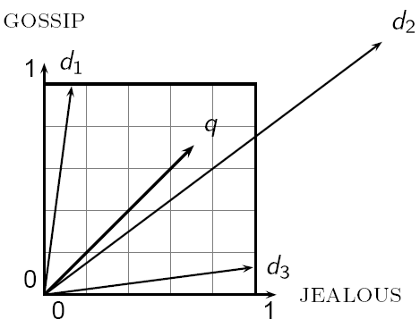
Why distance is a bad idea
The Euclidean distance between q
and d₂ is large even though the
distribution of terms in the document q and the distribution of
terms in the document d₂ are
very similar.

Slide 57
Use angle instead of distance
Thought experiment: take a document A and append it to itself. Call this document B.
“Semantically” A and B have the same content
The Euclidean distance between the two documents can be quite large
But, the angle between the two documents is 0, corresponding to maximal similarity

Slide 58
From angles to cosines
The following two notions are equivalent.
Rank documents in decreasing order of the angle between query and document
Rank documents in increasing order of cosine(query,document)
Cosine is a monotonically decreasing function for the interval [0º, 180º]

Slide 59
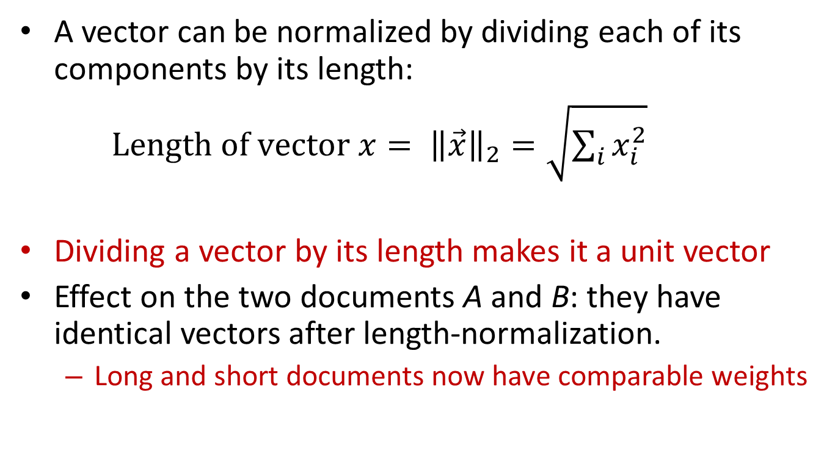
Length normalization
A vector can be normalized by dividing each of its components by its length:
$Length of vector x= {\left\|\vec{x}\right\|}_{2}=\sqrt{\sum_{i}{x_{i}^{2}}}$
Dividing a vector by its length makes it a unit vector
Effect on the two documents A and B: they have identical vectors after length-normalization.
Long and short documents now have comparable weights

Slide 60
Cosine for length-normalized vectors
For length-normalized vectors, cosine similarity is simply the dot product:
IF q, d are normalized

Slide 61
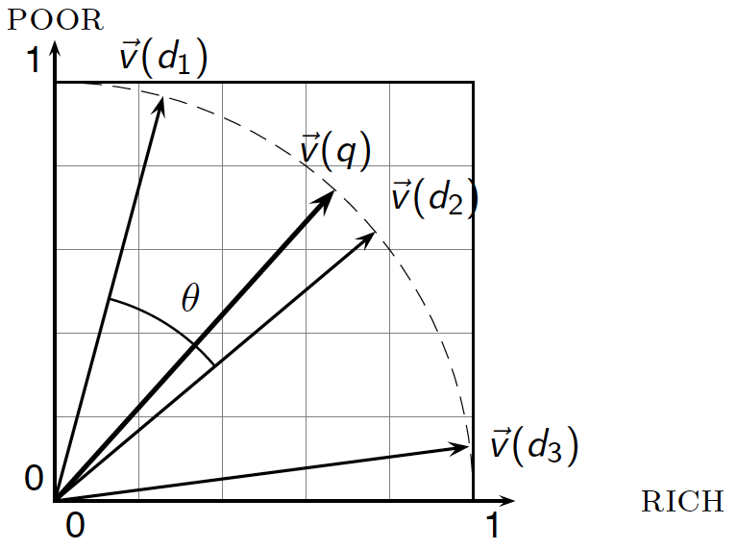
Cosine similarity illustrated

Slide 62
Cosine similarity amongst 3 documents
How similar are
the novels
SaS: Sense and
Sensibility
PaP: Pride and
Prejudice, and
WH: Wuthering
Heights?
term | SaS | PaP | WH
affection | 115 | 58 | 20
jealous | 10 | 7 | 11
gossip | 2 | 0 | 6
wuthering | 0 | 0 | 38
Word counts
Note: To simplify this example, we don’t do idf weighting.

Slide 63
Cosine similarity amongst 3 documents
Term frequency weighting
After length normalization
term | SaS | PaP | WH
affection | 0.905 | 0.892 | 0.267
jealous | 0.0787 | 0.108 | 0.147
gossip | 0.0157 | 0 | 0.08
wuthering | 0 | 0 | 0.506
term | SaS | PaP | WH
affection | 0.996 | 0.992 | 0.447
jealous | 0.0866 | 0.119 | 0.245
gossip | 0.017 | 0 | 0.134
wuthering | 0 | 0 | 0.849
cos(SaS,PaP) ≈
0.996×0.992 + 0.0866×0.119 + 0.017×0 + 0×0 ≈ 0.998
cos(SaS,WH) ≈ 0.468
cos(PaP,WH) ≈ 0.472

